Slide 1
Kickstarter: A Consumer’s Gamble
By: Kandy Ho and Roger Miao
CSC 171-01

Slide 2
Introduction
Topic: Kickstarter Projects
Dataset: 2010-2018 Kickstarter Projects from Kaggle
Project: Comparing SVM and Logistic Regression to MLP

Slide 3
The Problem with Kickstarter
The Kickstarter market is saturated with projects trying to receive funding
If you back a project that ends up failing, you essentially waste your time
Our project trains three models: SVM, LR, and MLP
We then use those models to predict the outcome of live projects.

Slide 4
Pruning
We felt that there were too many projects that ended up slowing down our notebook
We ended up pruning our dataset by removing projects with the launch date of 2010-2016
We also removed projects with funding goals less than $8000

Slide 5
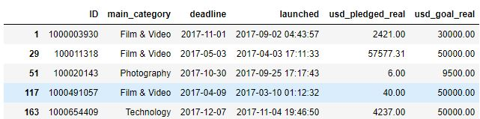
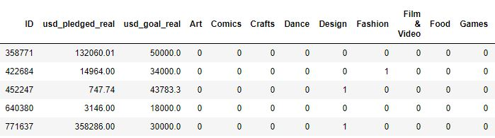
One Hot Encoding

Slide 6
Feature Selection
We selected features that we thought would help in predicting the outcome of a project
These features were: category, days active, usd_goal_real, and usd_pledged_real

Slide 7
Feature Normalization
Some of our features were not ideal for classification
For days active, use_real_goal, and usd_pledged_real we normalized them using Z Score

Slide 8
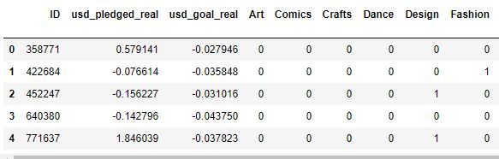
Feature Normalization

Slide 9
Parameter Tuning
We used gridsearch on each algorithm to find the best fitting parameters for each function call.

Slide 10
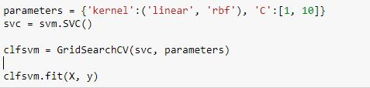
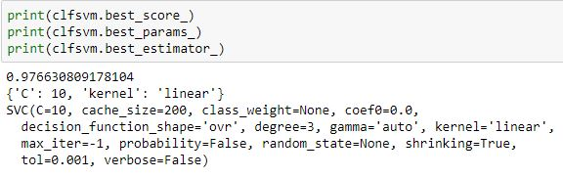
Parameter Tuning

Slide 11
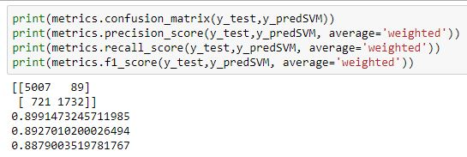
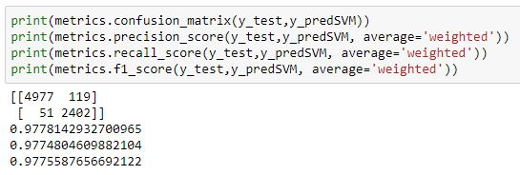
Parameter Tuning
Before:
After:

Slide 12
Support Vector Machine(SVM)
Precision: 0.9778142932700965
Recall: 0.9774804609882104
F1 Score: 0.9775587656692122

Slide 13
Logistic Regression(LR)
Precision: 0.9950361690364403
Recall: 0.9949662206914823
F1 Score: 0.994975633349279

Slide 14
Multilayer- Perceptron Classifier(MLP)
Precision: 0.9901104090953595
Recall: 0.9897999735064247
F1 Score: 0.9898399580278887

Slide 15
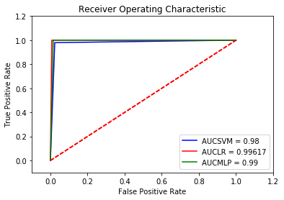
ROC Curve

Slide 16
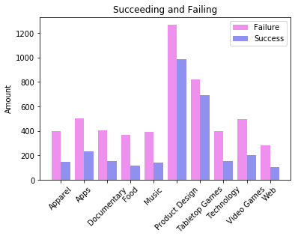
Amount of Projects Succeeding or Failing

Slide 17
Questions?

